Slide 1
PySpark: Spark with Python

Slide 2
Overview of PySpark
Apache Spark is wri en in Scala
To support Python with Spark, Apache Spark Community released PySpark Similar computation speed and power as Scala
PySpark APIs are similar to Pandas and Scikit-learn

Slide 3
What is Spark shell?
Interactive environment for running Spark jobs Helpful for fast interactive prototyping
Spark’s shells allow interacting with data on disk or in memory Three di erent Spark shells:
Spark-shell for Scala
PySpark-shell for Python SparkR for R

Slide 4
PySpark shell
PySpark shell is the Python-based command line tool
PySpark shell allows data scientists interface with Spark data structures PySpark shell support connecting to a cluster

Slide 5
Understanding SparkContext
SparkContext is an entry point into the world of Spark An entry point is a way of connecting to Spark cluster An entry point is like a key to the house
PySpark has a default SparkContext called sc

Slide 6
Inspecting SparkContext
Version: To retrieve SparkContext version
sc.version
2.3.1
Python Version: To retrieve Python version of SparkContext
sc.pythonVer
3.6
Master: URL of the cluster or “local” string to run in local mode of SparkContext
sc.master
local[*]

Slide 7
Loading data in PySpark
SparkContext's parallelize()
method
rdd = sc.parallelize([1,2,3,4,5])
SparkContext's textFile()
method
rdd2 = sc.textFile("test.txt")

Slide 8
Use of Lambda function in python - filter()
B I G DATA F U N DA M EN TA L S W I T H P YS PA R K
Upendra Devise y
Science Analyst, CyVerse

Slide 9
What are anonymous functions in Python?
Lambda functions are anonymous functions in Python
Very powerful and used in Python. Quite e cient with map()
and filter()
Lambda functions create functions to be called later similar to def
It returns the functions without any name (i.e anonymous) Inline a function de nition or to defer execution of a code

Slide 10
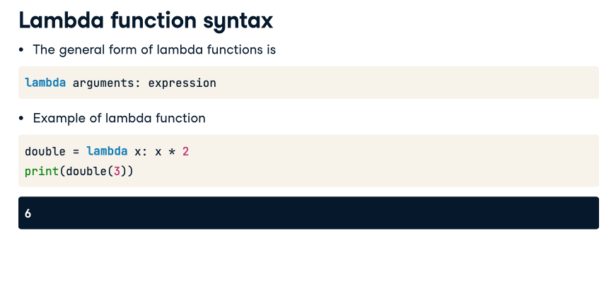
6

Slide 11
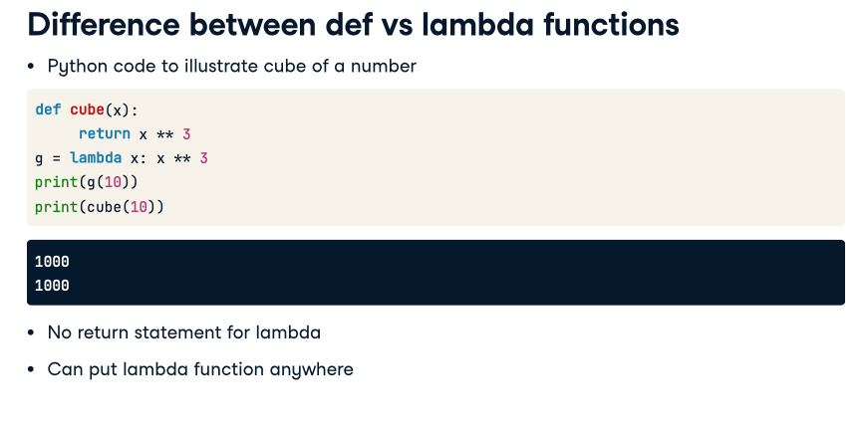

Slide 12
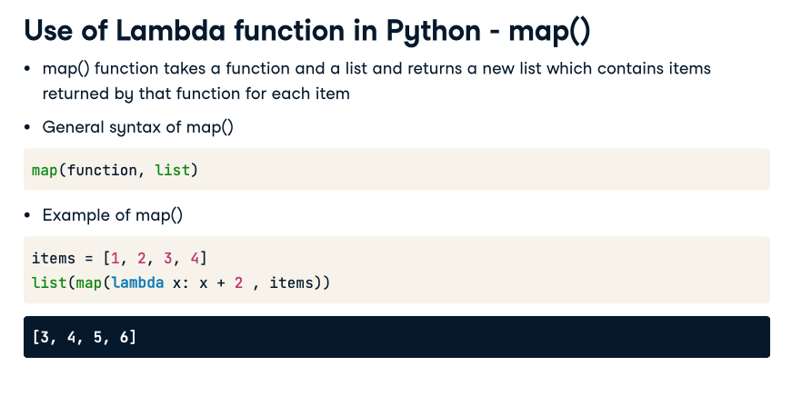

Slide 13
